Slide 1
NETWORK OF CHARACTER IN BOOK BY GORGE R. R. MARTIN
MIRTUNJAY(16BCE1179)
ASHUTOSH(16BCE1328)

Slide 2
GRAPH INTERACTION
Character Interaction Networks for George R. R. Martin's "A Song of Ice and Fire" saga
These networks were created by connecting two characters whenever their names (or nicknames) appeared within 15 words of one another in one of the books in "A Song of Ice and Fire." The edge weight corresponds to the number of interactions.
Two characters appearing together in the same location
Two characters in conversation
One character talking about another character
One character listening to a third character talk about a second character
A third character talking about two other characters

Slide 3
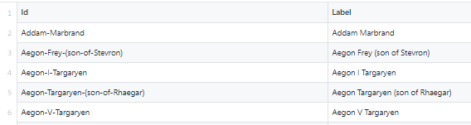
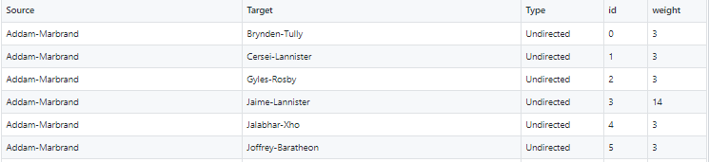
DATASET
EDGE OF GRAPH
NODE OF GRAPH

Slide 4
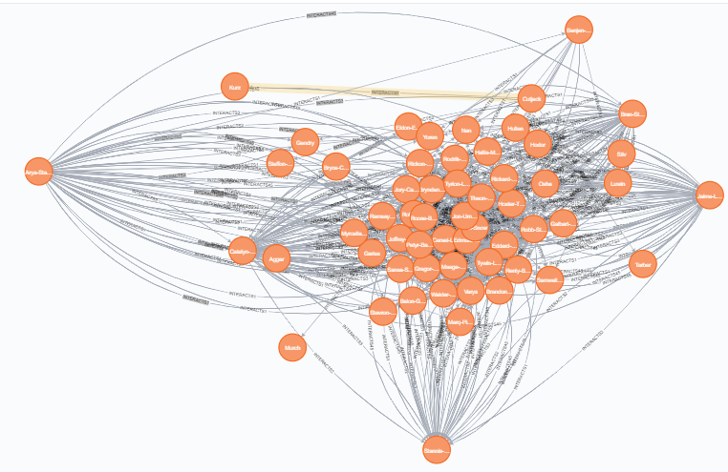

Slide 5
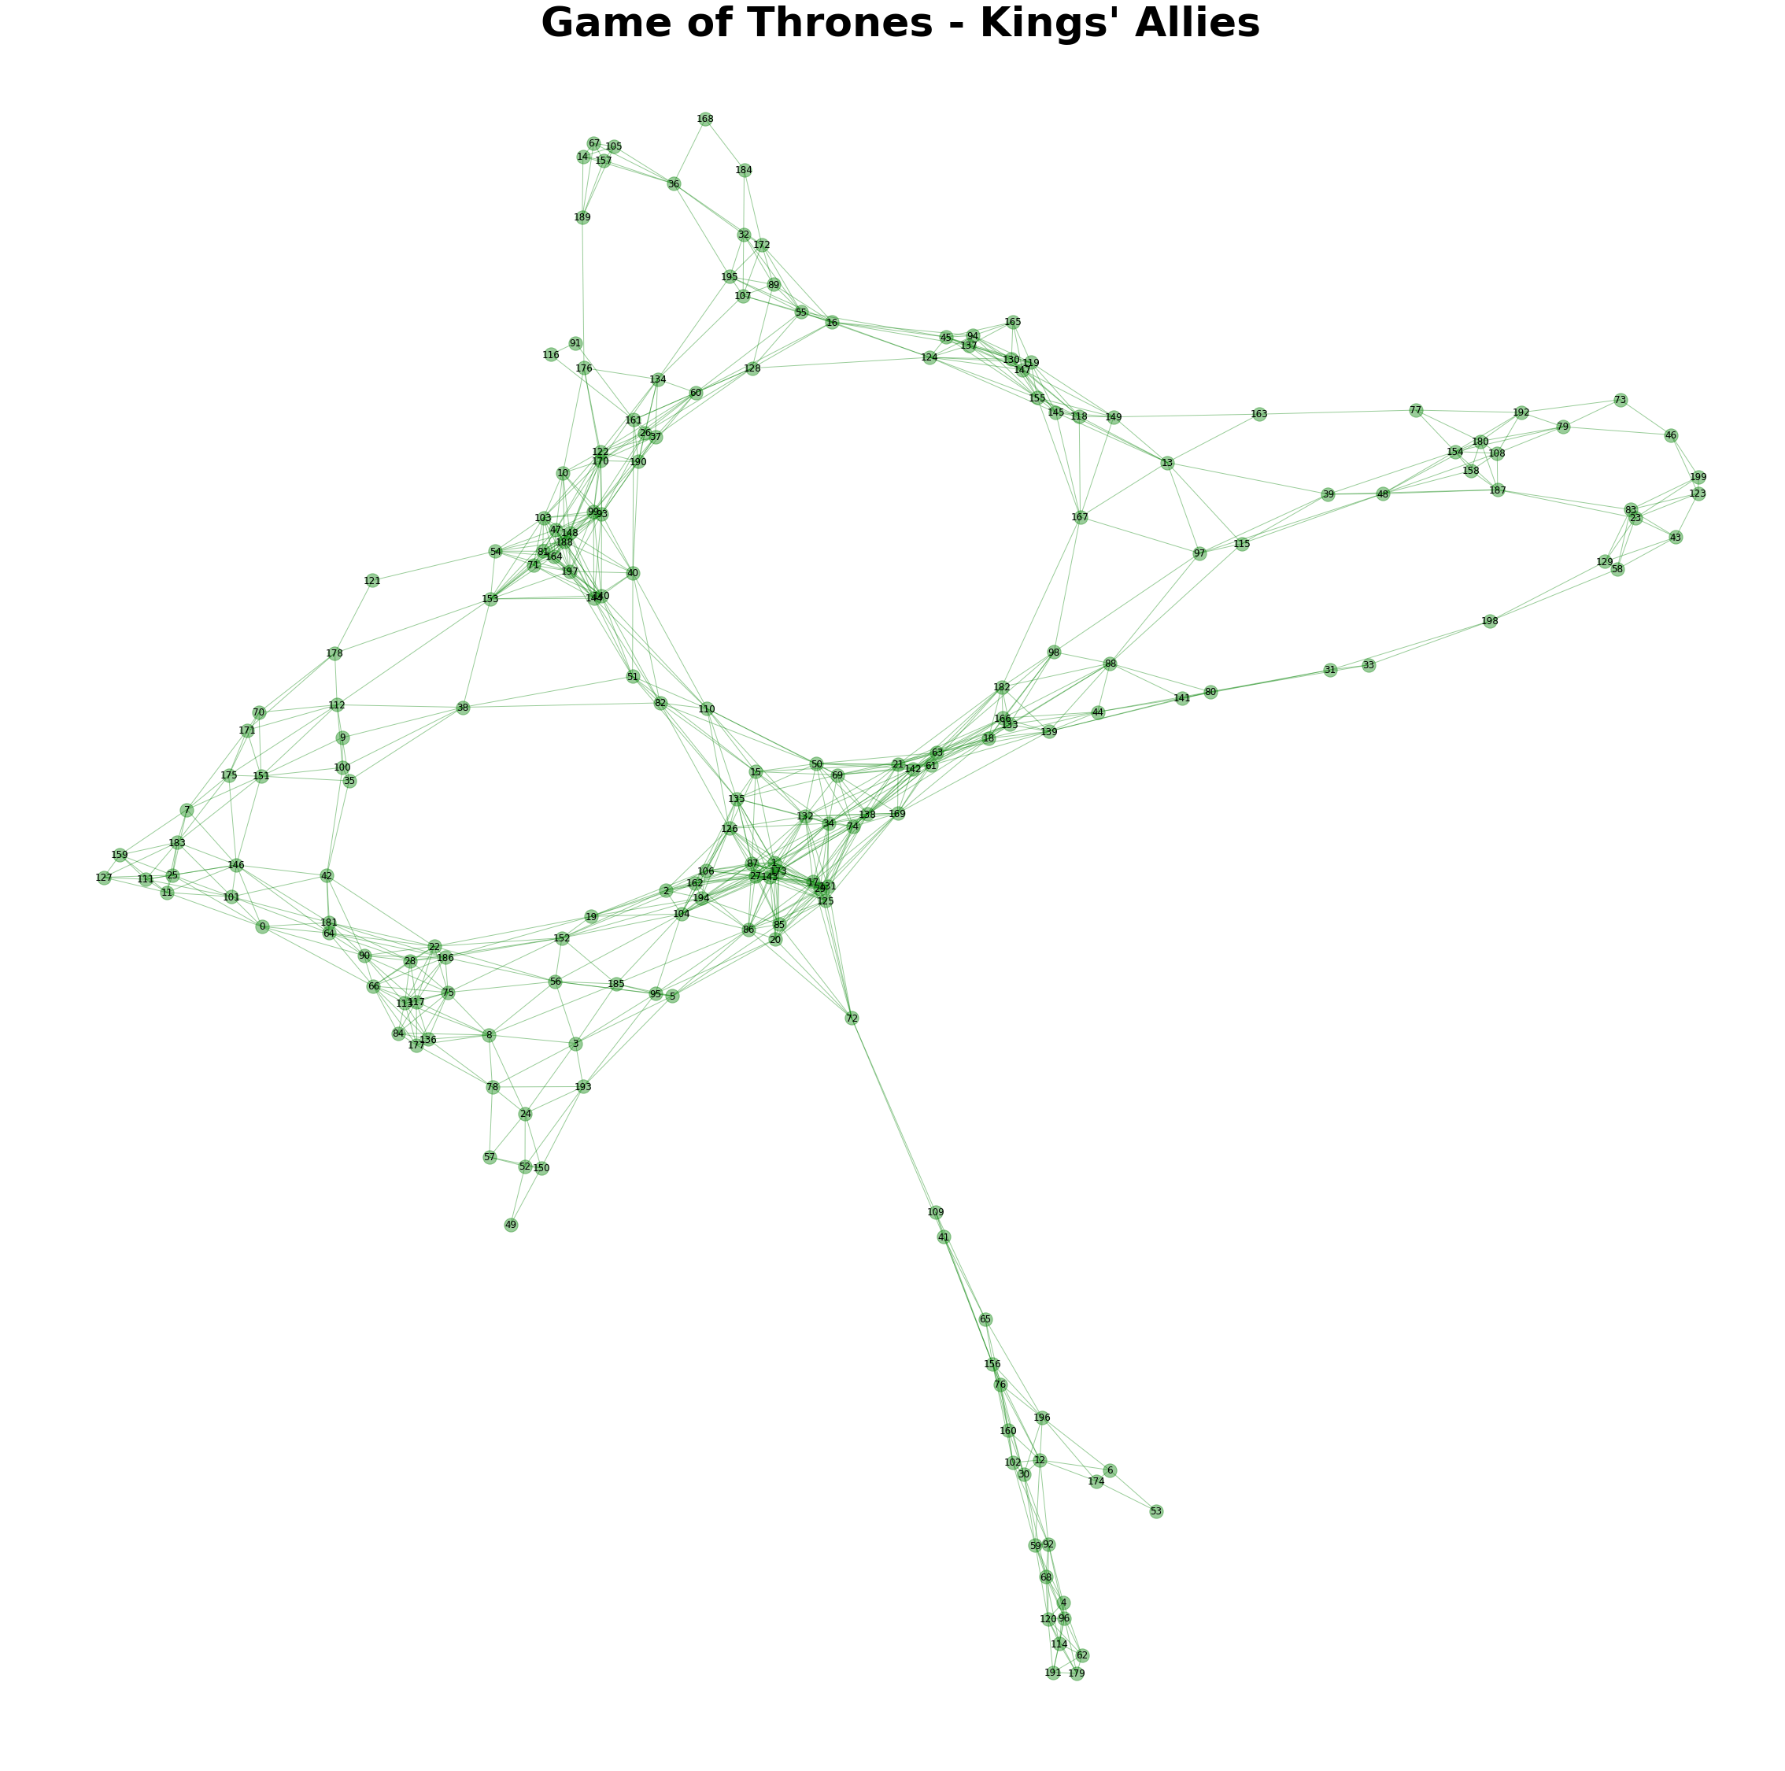

Slide 6
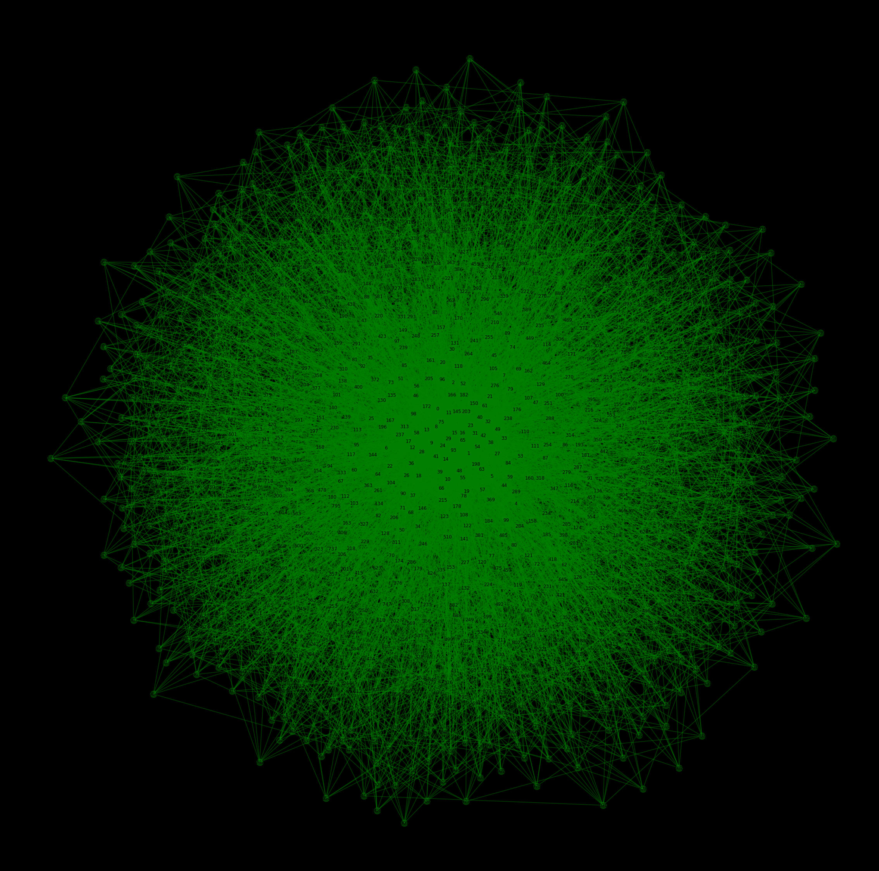


Slide 7
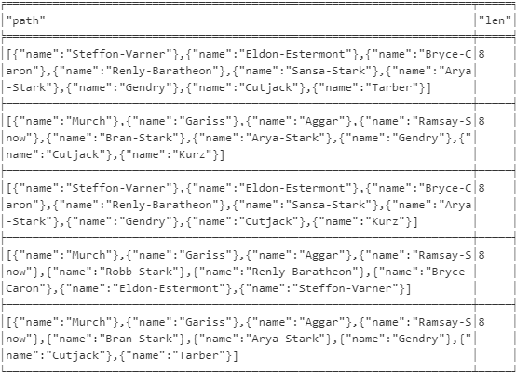
Diameter of the network
The diameter (or geodesic) of a network is defined as the longest shortest path in the network.

Slide 8
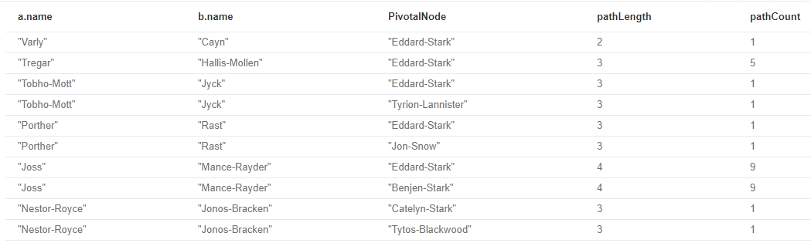
Pivotal nodes
A node is said to be pivotal if it lies on all shortest paths between two other nodes in the network. We can find all pivotal nodes in the network.

Slide 9
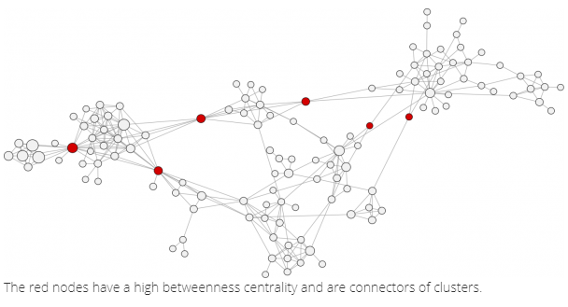
Betweenness Centrality
Betweenness centrality identifies nodes that are strategically positioned in the network, meaning that information will often travel through that person. Such an intermediary position gives that person power and influence.
Betweenness centrality is a raw count of the number of short paths that go through a given node. For example, if a node is located on a bottleneck between two large communities, then it will have high betweenness.

Slide 10
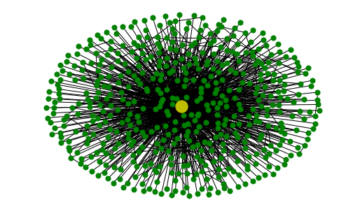

Slide 11
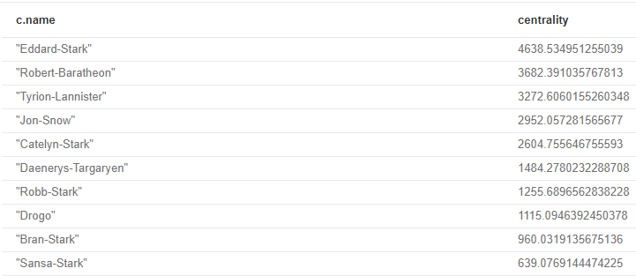
Most Influential Person In Book

Slide 12
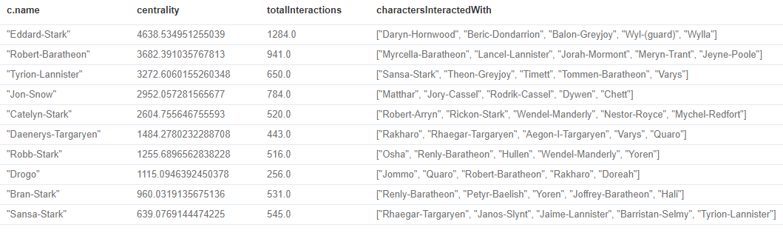
Betweenness Centrality vs Biggest Communicators
From this query we can see that it’s not necessarily the most talkative characters that have the most influence on the network.

Slide 13
PageRank
This is another version of weighted degree centrality with a feedback loop. This time, you only get your “fair share” of your neighbor’s importance.
i.e. your neighbor’s importance is split between their neighbors, proportional to the number of interactions with that neighbor.
Intuitively, PageRank captures how effectively you are taking advantage of your network contacts. In our context, PageRank centrality nicely captures narrative tension. Indeed, major developments occur when two important characters interact.

Slide 14





Slide 15
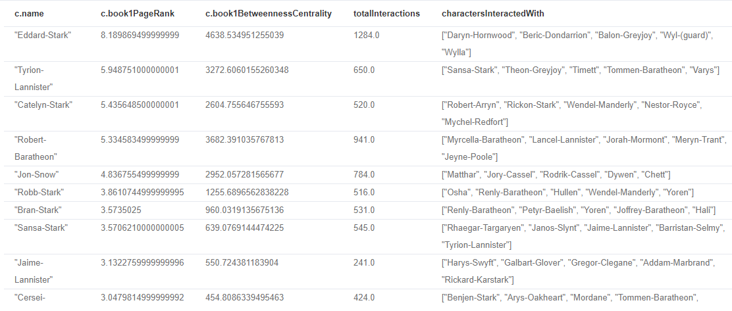
Querying PageRank
We can now write a query to see how influential the characters are across a variety of different metrics:
You’ll notice that there are some characters who have a high page rank but a very low betweenness centrality score.
This suggests that they aren’t necessarily influential in their own right, but are friends with important people. Varys is a good example of a character that fits this profile.

Slide 16

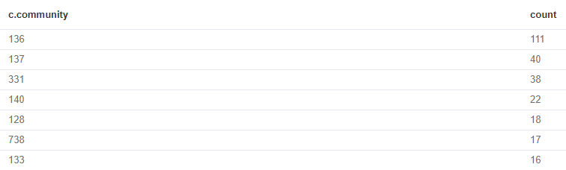
Community Detection
We can detect communities in our data by running an algorithm which traverses the graph structure to find highly connected subgraphs with fewer connections other other subgraphs
what communities we have and how many members they have:

Slide 17
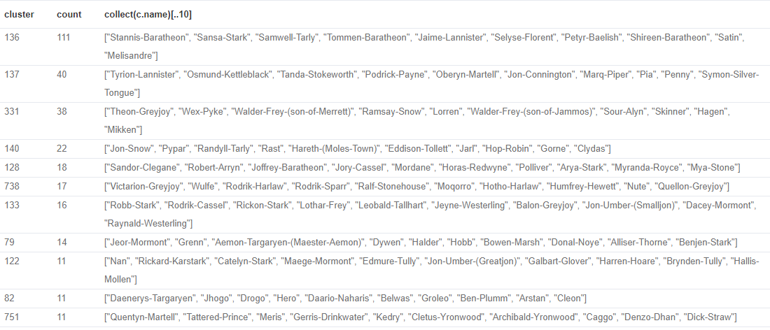
Querying Communities
It’d be good to know who are the influential people in each community. To do that we’ll need to calculate a PageRank score for each character across all the book

Slide 18
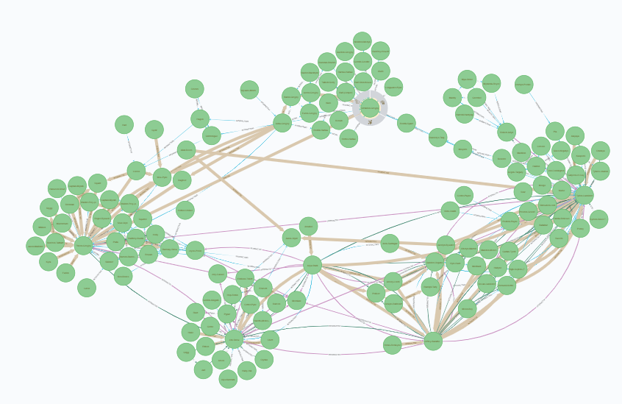

Slide 19
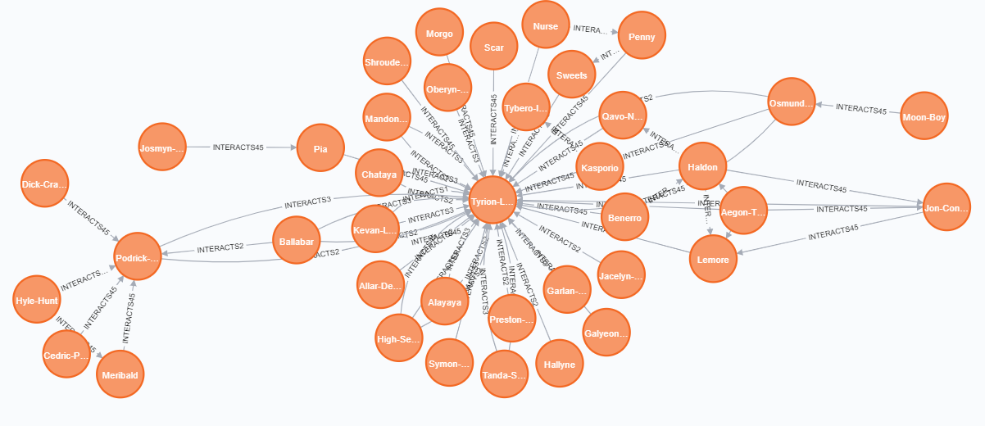

Slide 20
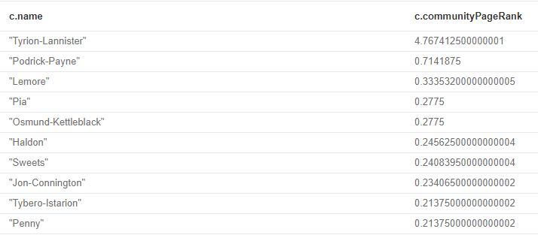
Intra community PageRank
We can also calculate the PageRank within communities to find most influential character within community

Slide 21
THANK YOU !

